Slide 1
LECTURE 7

Slide 2
11
A hot plate of an electric oven connected to a 220 V line has two resistance coils A and B, each of 24 Ω resistances, which may be used separately, in series, or in parallel. What are the currents in the three cases ?
R=24Ω
R=24Ω
R=24Ω
R=24Ω
R=24Ω
R=24Ω
R=24Ω
+
I
+
I
+
I
220 V
220 V
220 V
I₁ = ?
A
I₂ = ?
A
I₃ = ?
A
–
–
–
K
K
K

Slide 3














11
A hot plate of an electric oven connected to a 220 V line has two resistance coils A and B, each of 24 Ω resistances, which may be used separately, in series, or in parallel. What are the currents in the three cases ?
Given :
Voltage (V)
= 220 V
$$\frac{\text{V}}{\text{R}}$$
$$\frac{\text{220}}{\text{24}}$$
Case III : Coils in parallel
∴
I₁
=
=
Resistance (R)
= 24 Ω
Total resistance in parallel
∴
I₁
=
9.166 A
$$\frac{\text{1}}{\text{R}\text{P}}$$
$\frac{\text{1}}{\text{R}}$ + $\frac{\text{1}}{\text{R}}$
To find :
Current when coils are used separately (I₁)
=
= ?
Case II : Coils in series
$$\frac{\text{1}}{\text{R}\text{P}}$$
$\frac{\text{1}}{\text{24}}$ + $\frac{\text{1}}{\text{24}}$
$\frac{\text{2}}{\text{24}}$
Current of series combination (I₂)
= ?
Total resistance in series
∴
=
=
Current of parallel combination (I₃)
= ?
R_{S}
=
R + R
∴
R_{P}
=
$\frac{\text{24}}{\text{2}}$
Formulae :
V
=
IR
∴
R_{S}
=
24 + 24
R_{S}
=
R₁ + R₂
∴
R_{S}
=
48 Ω
∴
R_{P}
=
12 Ω
$$\frac{\text{1}}{\text{R}\text{P}}$$
$\frac{\text{1}}{\text{R}\text{1}}$ + $\frac{\text{1}}{\text{R}\text{2}}$
According to ohm’s law
According to ohm’s law
=
V
=
I₂R_{S}
V
=
I₃R_{P}
Solution :
Case I : Coils used separately
$$\frac{\text{V}}{\text{R}\text{S}}$$
$$\frac{\text{220}}{\text{48}}$$
$$\frac{\text{V}}{\text{R}\text{P}}$$
$$\frac{\text{220}}{\text{12}}$$
∴
I₂
=
=
∴
I₃
=
=
According to ohm’s law
The currents flowing through the coils when they are used separately, in series and in parallel are 9.166 A, 4.58 A and 18.33 A respectively
Ans :
V
=
I₁R
∴
I₂
=
4.58 A
∴
I₃
=
18.33 A

Slide 4


Type - b
V
=
IR
numerical
ρl
R
=
(A = πr²)
A

Slide 5

1
(a) How much current will an electric bulb draw from a 220 V source, if the resistance of the bulb filament is 1200 Ω ?
(b) How much current will an electric heater coil draw from a 220 V source, if the resistance of the heater coil is 100 Ω ?
R₁ = 1200 Ω
R₂ = 100 Ω
I₁ = ?
I₂ = ?
+
–
+
–
V₁ = 220V
V₂ = 220V
1st circuit
2nd circuit

Slide 6
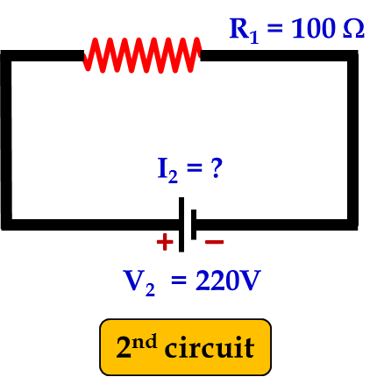
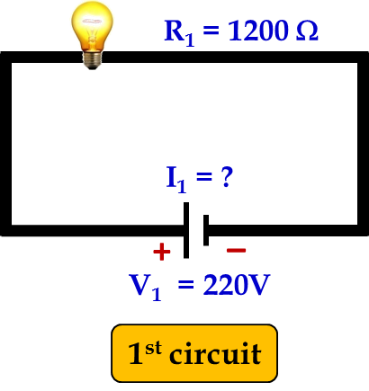
1
(a) How much current will an electric bulb draw from a 220 V source, if the resistance of the bulb filament is 1200 Ω ?
(b) How much current will an electric heater coil draw from a 220 V source, if the resistance of the heater coil is 100 Ω ?
Given :
V₁ = 220 V;
R₁ = 1200 Ω,
V₂ = 220 V;
R₂ = 100 Ω.
To find :
I₁ = ?
I₂ = ?
Formula:
V = IR
Solution :
V₁ = I₁R₁
V₂ = I₂R₂
∴
220
=
I₁
×
1200
∴
220
=
I₂
×
100
11
220
22
220
22
∴
I₁
=
=
I₂
=
=
1200
120
∴
60
100
10
I₁ = 0.18 A
I₂ = 2.2 A
Ans :
Current through bulb is 0.18 A
Current through heater is 2.2 A

Slide 7


2
The potential difference between the terminals of an electric heater is 60 V when it draws a current of 4 A from the source. What current will the heater draw if the potential difference is increased to 120 V ?
Given :
Potential difference (V)
= 60 V
Current (I)
= 4 A
Increased Potential difference (V_{i})
= 120 V
‘V’ is increased but ‘R’ remains constant
To find :
Current (I)
= ?
Formula :
V =
IR
When V is increased to 120V then,
Solution :
V =
IR
V_{i}
$$\frac{\text{V}}{\text{I}}$$
I
=
∴
R =
R
120
8
$$\frac{\text{60}}{\text{4}}$$
15
=
∴
R =
15
1
1
∴
I =
8 A
∴
R =
15 Ω
Ans :
The current in the heater is 8 A

Slide 8
Resistance of a metal wire of length 1 m is 26 Ω at 20°C. If the diameter of the wire is 0.3 mm, what will be the resistivity of the metal at that temperature?
3
Ans :
(R)
= 26 Ω
(l)
= 1m
(d)
= 0.3 mm
l = 1m
d = 0.3mm
∴ r
= 0.15 mm
R = 26 Ω
= 15 x 10⁻⁵m
R =
ρ
l
A
R x A
R x πr²
∴ ρ =
=
l
l
26 x 3.14 x (15 x 10⁻⁵)²
=
ρ =
1.84 x 10⁻⁶ Ωm
1
=
26 x 3.14 x 225 x 10⁻⁶
∴ Resistivity of metal = 1.84 × 10^{–6} Ωm

Slide 9
4
A wire of given material having length l and area of cross section A has a resistance of 4 Ω. What would be the resistance of another wire of the same material having length l/2 and area of cross section 2A?
Ans :
(i)
For 1st wire :
A
ρ
l
l
R₁ =
= 4 Ω
… … … …(i)
Wire
A
(ii)
For 2nd wire :
l/2
ρ
l / 2
2A
R₂ =
2A
1
ρ
l
=
4
A
1
x R₁
… … … [from (i)]
=
4
1
x 4
=
4
∴ R₂ =
1 Ω
∴ The resistance of new wire is 1 Ω

Slide 10

Q.5.
When a 12V battery is connected across an unknown resistor, there is a current of 2.5 mA in the circuit. Find the value of the resistance of the resistor.
Given :
V
= 12 V
I
= 2.5 mA
= 2.5 x 10⁻³ A
To find :
R
= ?
V
Formula :
R
=
I
12V
Solution :
R
=
2.5 x 10⁻³
= 4800 Ω
The value of the resistance of the resistor is 4800 Ω

Slide 11
Q.6.
Let the resistance of an electrical component remains constant while the potential difference across the two ends of the component decrease to half of its former value. What change will occur in the current through it?
Ans :
According to Ohm’s law,
V = IR
V
… … … (i)
∴
I =
R
Now, the potential difference is reduced to half.
V
… … … (ii)
1
V
New potential difference V’ =
=
x
2
2
R
∴ Resistance remains constant,
1
I’ =
I
V’
2
New current I’ =
R
V
∴ The current through the component will also become half.
New current I’ =
[from(ii)]
2R

Slide 12
Q.7.
(a) Draw a schematic diagram of a circuit consisting of a battery of three cells of 2 V each, a 5 Ω resistor, an 8 Ω resistor, and a 12 Ω resistor and a plug key, all connected in series.
(b) Redraw the above circuit putting an ammeter to measure current through the resistors and a voltmeter to measure potential difference across 12 Ω resistor. What would be the readings in ammeter and voltmeter.
Ans. :
Since all the three resistors are in series,
(a)
(b)
+
-
5Ω
8Ω
12Ω
V
Total Resistance R = 5 + 8 + 12
= 25 Ω
5Ω
8Ω
12Ω
+
V
6
+
2V
2V
+
∴ Current I =
=
2V
R
25
2V
A
2V
-
2V
-
-
= 0.24 A
Across 12Ω resistor, potential difference
(
(
(
(
V = IR
K
K
∴ Ammeter Reading = 0.24 A
Voltmeter Reading = 2.88 V
= 0.24 x 12
= 2.88 V

Slide 13


5
A copper wire of length 2 m and area of cross-section 1.7 × 10⁻⁶ m² has a resistance of 2 × 10⁻² ohms. Calculate the resistivity of copper
Given :
Length (l)
= 2 m
Area (A)
= 1.7 × 10⁻⁶ m²
l = 2m
A = 1.7 × 10⁻⁶ m²
Resistance (R)
= 2 × 10⁻² Ω
R = 2 × 10⁻² Ω
To find :
Resistivity (ρ)
= ?
$$\frac{\text{r}\text{l}}{\text{A}}$$
Formula :
R =
$$\frac{\text{r}\text{l}}{\text{A}}$$
Solution :
R =
R × A
ρ =
l
2 × 10⁻²
× 1.7 × 10⁻⁶
ρ =
=
1.7 × 10⁻⁸ Ω m
2
Ans :
The resistivity of copper is 1.7 × 10⁻⁸ Ω m

Slide 14
Thank You

